Slide 1
Computer Graphics (ICT Ed 466 ) Case Study Report on LED and LCD Technologies
Presented By:
Abishek Khawas
Shankar Khawas
Nirajan Subedi
Sudip Koyong

Slide 2
1. Introduction
Liquid Crystal Display (LCD) and Light Emitting Diode (LED) technologies are essential to modern electronic displays. They have transformed devices like TVs, monitors, and smartphones. This case study covers their basics, development, uses, and future potential. This report explores the fundamentals, development, applications, and future prospects of these technologies.

Slide 3
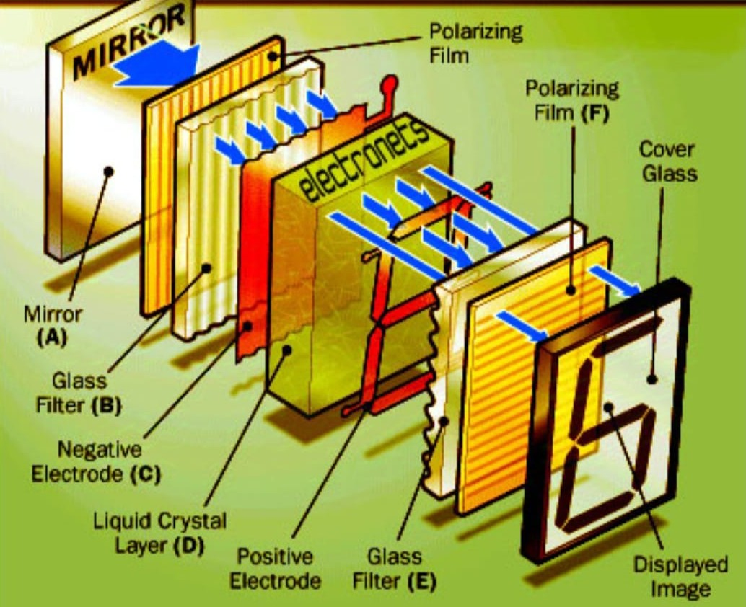
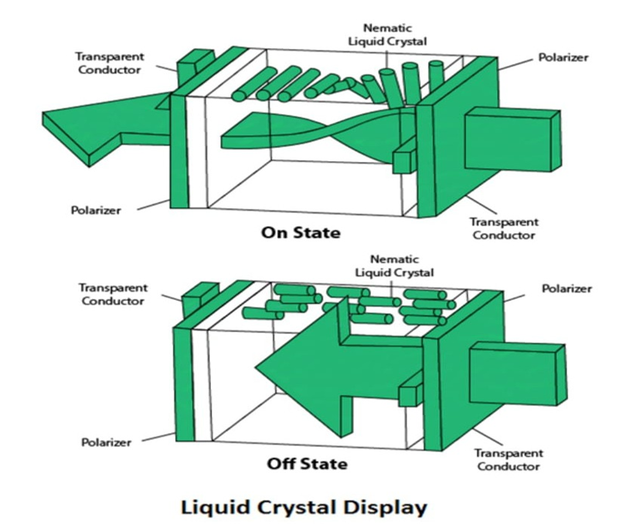
LCD Technology (Liquid Crystal Display): A Liquid Crystal Display is a flat-panel display technology that uses liquid crystals to modulate light. It is commonly used in televisions, computer monitors, smartphones, and many other electronic devices.

Slide 4
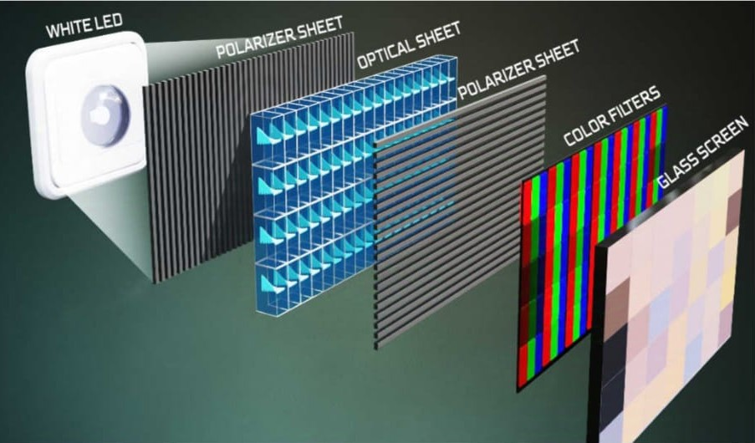
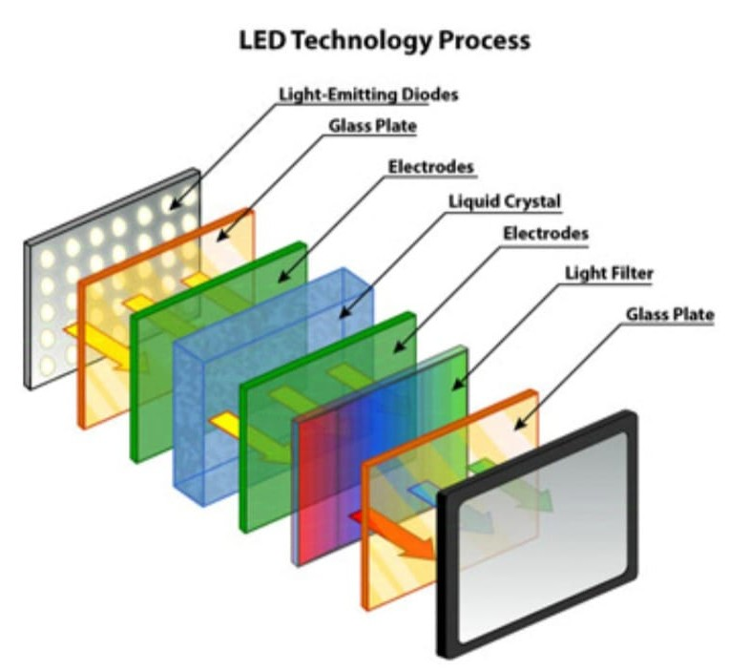
LED (Light Emitting Diodes) Technology: Utilizes Light Emitting Diodes (LEDs) either as standalone light sources (direct-view LED) or as backlighting for LED-backlit LCDs. Advances like Mini-LED and Micro-LED enhance brightness and contrast significantly.

Slide 5
3. Historical Development
LCDs emerged in the 1960s, gaining popularity in the 1980s with advances in thin-film transistor (TFT) technology.
LEDs were developed earlier in the 1960s, but their integration into displays took shape in the 2000s, replacing CCFLs(Cold Cathode Fluorescent Lamp.) in LCD backlighting.

Slide 6
4. Comparison of LCD and LED
Picture Quality:
LED-backlit LCDs are better than traditional CCFL-backlit LCDs because they have higher contrast and brightness.
Direct-view LED displays provide superior image quality and colour accuracy.
Energy Efficiency:
LEDs consume less power compared to CCFLs, making LED-backlit LCDs more energy-efficient.
Lifespan and Durability:
LEDs have a longer lifespan and are more durable, with reduced susceptibility to burn-in compared to some LCD technologies.
Cost:
LCDs are more cost-effective than LED displays, though the price gap is narrowing with technological advancements.

Slide 7
5. Applications
LCDs:
Dominant in TVs, computer monitors, digital signage, and mobile devices.
Affordable and versatile for general use.
LED Displays:
Widely used in outdoor signage, stadium displays, and premium televisions.
Micro-LED displays are gaining traction in luxury applications due to their exceptional quality.

Slide 8
6. Technological Advancements
Quantum Dot Technology:
Enhances colour reproduction and efficiency in both LCD and LED systems.
Mini-LED and Micro-LED:
Provide finer control over brightness and contrast, improving image quality.
OLED vs. LED:
Organic Light Emitting Diodes (OLEDs) are emerging as a competitor, offering better contrast but at higher costs.

Slide 9
7. Visual Comparisons
Feature | LCD | LED
Backlighting | CCFL or LED | LED or self-illuminating
Picture Quality | Good | Excellent
Energy Consumption | Moderate | Low
Durability | Moderate | High
Cost | Lower | Higher

Slide 10
8. Future Prospects
The integration of AI and IoT in displays will enable smart functionality.
Continued development in Micro-LED technology promises higher efficiency and better scalability.
Research into reducing production costs aims to make high-end displays more accessible.

Slide 11
9. Conclusion
Both LCD and LED technologies have transformed the display industry, with distinct strengths catering to various applications. Advancements in quantum dots, Mini-LED, and Micro-LED technologies will shape their evolution, ensuring their relevance in a rapidly advancing digital world.

Slide 12
Thank You

